Slide 1

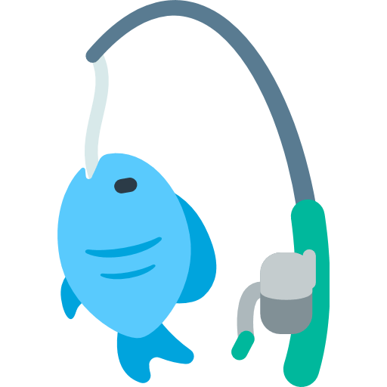

FAZE*
*Like WAZE but for fishing

